Slide 1
Amelia Earhart

Slide 2
Facts about Amelia Earhart
Birth Name: Amelia Mary Earhart
Born: July 24, 1897
Birthplace: Atchison, Kansas
Died: July 2, 1937, en route from Lae, New Guinea to Howland Island
Married: February 7, 1931, to George Putnam

Slide 3
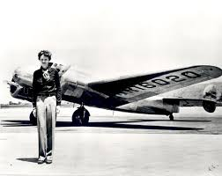
Amelia Mary Earhart was an American author.
Earhart was the first female pilot to fly solo across the Atlantic Ocean. She received the U.S. Distinguished Flying Cross for this record.

Slide 4
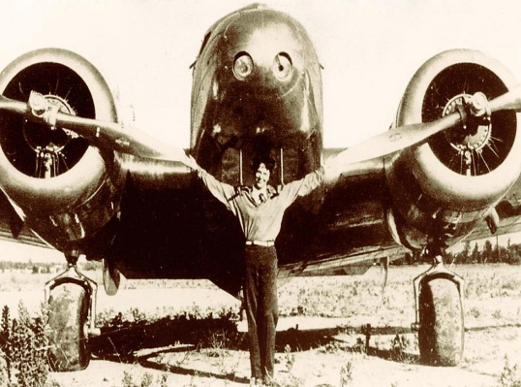
How did she first start flying an aeroplane!
On Dec. 28, 1920, Amelia Earhart paid a dollar for her first 10-minute airplane ride in California.
Amelia Earhart began taking flying lessons in January of 1921 and later that year bought her first airplane with money borrowed from her mother, father and sister as well as earned from her job as a telephone operator.

Slide 5
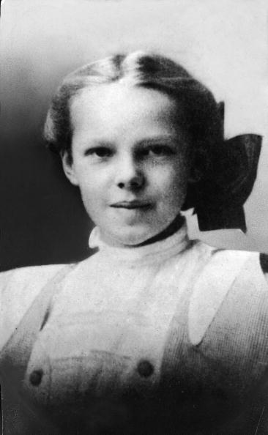
Where did Amelia Earhart grow up?
Growing up Amelia and her sister had all sorts of adventures. They collected insects and frogs. They liked to play sports including baseball and football. Amelia even learned to shoot a .22 rifle and used it to kill rats in her Dad's barn.

Slide 6
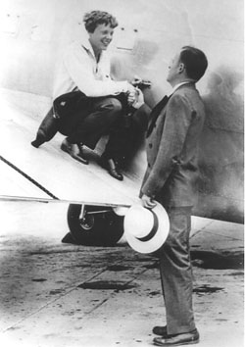
Facts
Amelia was named Amelia Mary Earhart after her two grandmothers, Amelia Harres Otis and Mary Wells Earhart -- a family tradition.
Amelia was initially engaged to be married to a New Englander named Sam Chapman, whom she met while visiting her parents in Los Angeles.

Slide 7
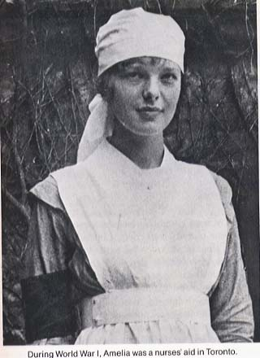
World war 1
During the First World War, Amelia left college and joined her sister in Toronto, Canada, to became a nurse's aid and care for the soldiers wounded in war.
After World War I Amelia Earhart returned to college and studied first automobile engine repair, then medicine and later medical research.

Slide 8
Answer:
No one knows what happened to the plane or where it landed or crashed. Many searches have been made . but nobody found anything.
How did Amelia Earhart crash?

Slide 9
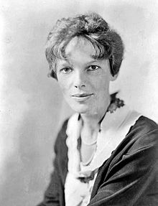
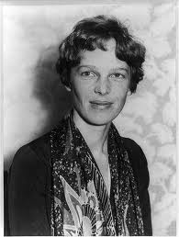
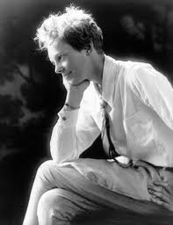
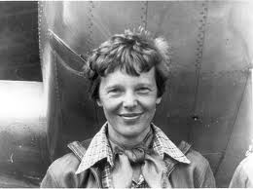
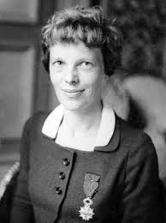
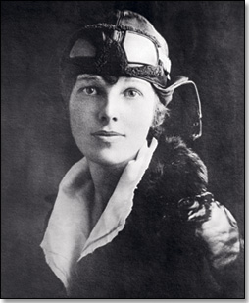
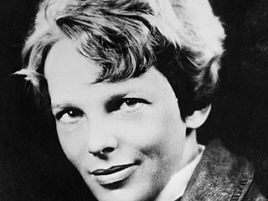
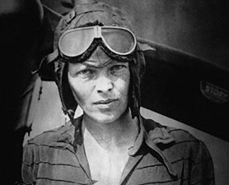
Pictures of
Amelia Earhart

Slide 10
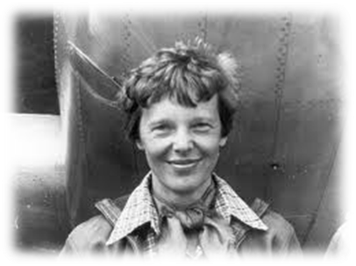
Never do things others can do and will do if there are things others cannot do or will not do.
Amelia’s words
Flying might not be all plain sailing, but the fun of it is worth the price.
The woman who can create her own job is the woman who will win fame and fortune.
Never interrupt someone doing what you said couldn't be done.
I want to do it because I want to do it.

Slide 11
by emerita

