Slide 1
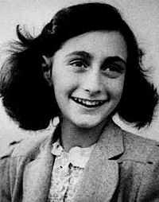
Anne Frank
By Nawal Faheem

Slide 2
Childhood
Anne Frank was a born on the 12th of June in 1929 in Frankfurt, Germany
Her parents were Otto and Edith.
She had only one sister, Margot
They lived in an apartment block from 1934 until 1942

Slide 3
War
Since Anne was a Jew, she had a vey hard life
I love potatoes
The quick brown fox jumps over the lazy dog

Slide 4
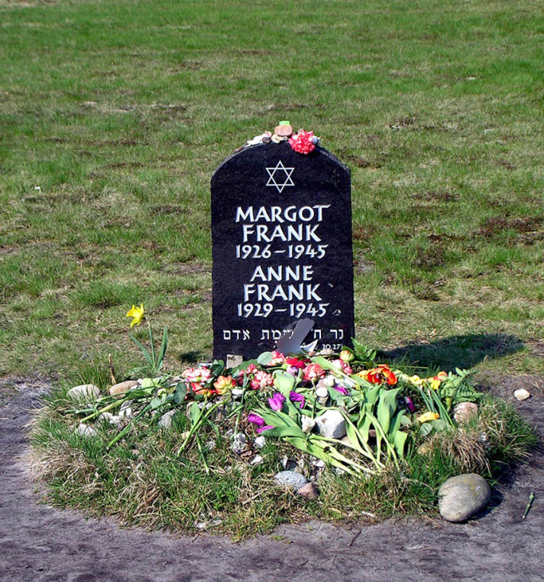
Anne Frank’s Death
Anne Frank died on the _____
She died from a spreading disease called typhus
Her body was buried with many others and was never found but they
still made a grave for Anne
and her sister
Even a movie was made in
About her life called

Slide 5
Anne’s Diary
Anne Frank got a diary for her 13th birthday from her father
It was actually an autograph book but they decided to use it as a diary
She wrote all about her life during the war
After she died her father published it __________

